Slide 1


BE TRUSTABLE

Slide 2
INDUSTRY PROBLEM
Corporations
Public Domain
CSR definitions vary, making it difficult to compare progress.
Unable to keep proper track of progress and impact.
Uncertainty of corporation’s loyalty or authenticity.
Not enough recognition or incentive for corporate responsibility.
Current reports are lengthy, boring, and biased.

Slide 3




SOLUTION
We want to create a global standard for how CSR is measured.
Accountability
User friendly platform
Gamification
Notes:
Accountability
Volunteer hours and donations made by the corporation will be verified and double checked by the organization they donated to, eliminating falsification or exaggeration of the company’s efforts.
Gamification
Create a competitive environment for companies by introducing CSR scores and leaderboards. This will incentivize companies to both fulfill their CSR promises as well as strive to do more, resulting in greater employee participation. Adds value to the company in terms of corporate citizenship.
User Friendliness
Information regarding company CSR efforts will be accessible in a simple and user-friendly manner on our web page. Rather than long CSR reports using jargon, we will provide users with an overview of the CSR landscape and keep them informed in terms of universal symbols and visuals.

Slide 4







USER VALIDATION
User Persona
Validation Methods
30+
Surveys to professionals from around the world
End user: public domain and companies’ employees
Urban professional aged between 20-60
Tech savvy Bay Area local
Frequent social media user
Willing to fight for social change
Enjoys hiking on the weekends
A quality over quantity user
engineering
research
finance
CS
banking
“
CSR plans of a company would surely be a factor to consider while looking to join any company.

Slide 5



VALUE PROPOSITION
A CSR platform that generates a standard benchmark score, boosts morale, and helps you engage and retain employees longer.

Slide 6



COMPETITIVE ANALYSIS
 | REPTRACK | BE TRUSTABLE
Strengths | Provides leaderboards ranking companies based on a number of factors including CSR to help them build credibility with their customers. | Gives validated and transparent information about the CSR efforts
Weakness | The metrics used to rank companies are not very transparent | Only takes volunteer hours and donations received as metrics so far.
Feature comparison | The leaderboard feature is the same but the company focuses on overall reputation of a company and not just CSR initiatives undertaken. | Use of blockchain for validated information.
Target market | Corporations. Global market | Corporations who have incorporated CSR in their business plan and NGOs. Projected market (in Bay Area): 15% SAM
Notes:
Targeting Bay Area: San Francisco County, San Mateo County, Santa Clara County, San Benito County, Alameda County, Contra Costa County, Marin County, Sonoma County, Solano County, Napa County. (data from 2017 collected from https://www.labormarketinfo.edd.ca.gov/LMID/Size_of_Business_Data.html)
Number of companies measured by no of employees (all the companies in the Bay Area -- the TAM) 1. 100-499 employees: 4,341 of these types of companies 2. 500-999: 314 3. >1000: 217
Assumed # companies engaged in CSR measured by no of employees (of these numbers, how many are engaged in CSR?) 1. 100-499: 70% → 3,039 2. 500-999: 75% → 236 3. >1000: 80% → 174
BeTrustable hit rate YR1; # companies measured by no of employees (of those numbers^, then how many would be interested?) 1. 100-499: 15% → 456 2. 500-999: 10% → 24 3. >1000: 8% → 14

Slide 7
BUSINESS MODEL FORMULA
Ads and Tiered Subscription Model
Pricing and User Acquisition (YR 1)
The ability to connect to individuals who are interested in service opportunities.
The ability to make targeted ads (charged at $5 CPM)
100-499 employees: $700
500-999 employees: $800
> 1000 employees: $900
23 companies
2 companies
3 companies
TIER 1 + TIER 2
The ability to see user’s industry, level of employment, and location
Access to data on website traffic
100-499 employees: $400
500-999 employees: $500
> 1000 employees: $600
113 companies
7 companies
4 companies
TIER 2 + TIER 3
100-499 employees: $100
500-999 employees: $200
> 1000 employees: $300
319 companies
14 companies
7 companies
TIER 3
Has the ability to see the number of clicks and searches for the company profile
Notes:
Ads & Tiered subscription model.
Pricing based on number of employees and tiered subscription. (YR 1 data)
Tier 1: Tier 2 + based on series of randomized user data collection with regards to volunteer interest, will have the ability to be connected to these individuals. Has the ability to make targeted ads.
100-499 employees: $700 → acquire 23 companies
500-999 employees: $800 → acquire 2 companies
>1000 employees: $900 → acquire 3 companies
Tier 2: Tier 3 + sees what industry user is currently employed in and what level of employment user has, as well as geographic location. Has access to data on what time and day there is most traffic on our website and has the ability to make ads.
100-499 employees: $400 → acquire 114 companies
500-999 employees: $500 → acquire 7 companies
>1000 employees: $600 → acquire 4 companies
Tier 3: Sees # of clicks and searches for the company profile.
100-499 employees: $100 → acquire 319 companies
500-999 employees: $200 → acquire 14 companies
>1000 employees: $300 → acquire 7 companies
Ads on our website charged @ $5CPM (assumed 50K visitors first month, and 150K visitors by end yr 1).

Slide 8
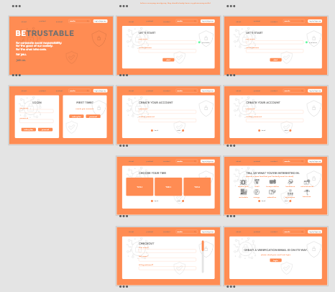
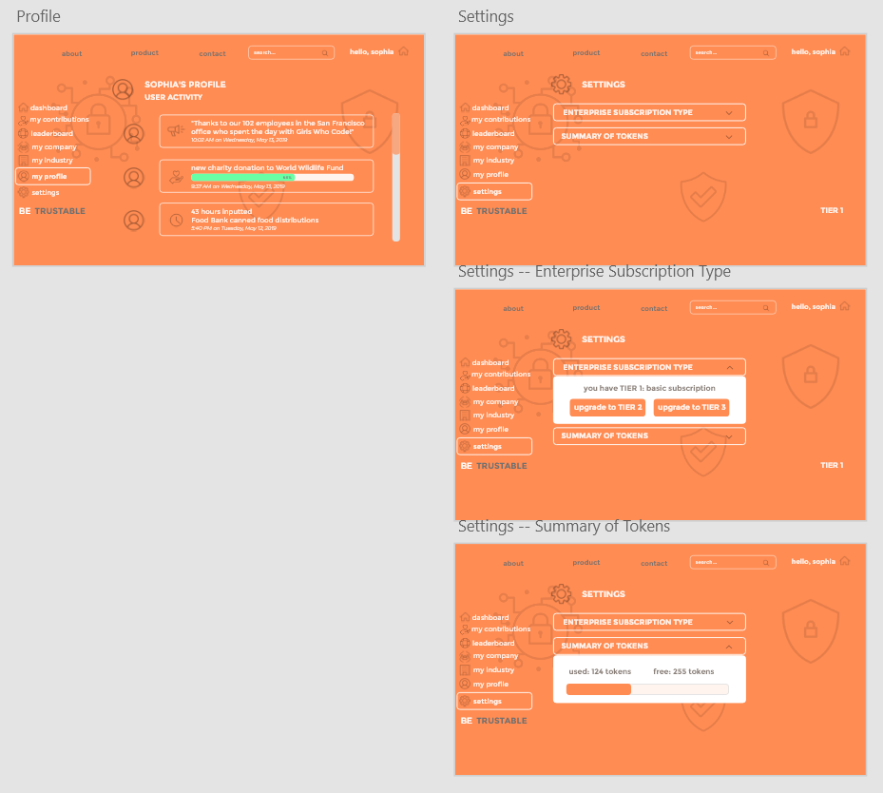
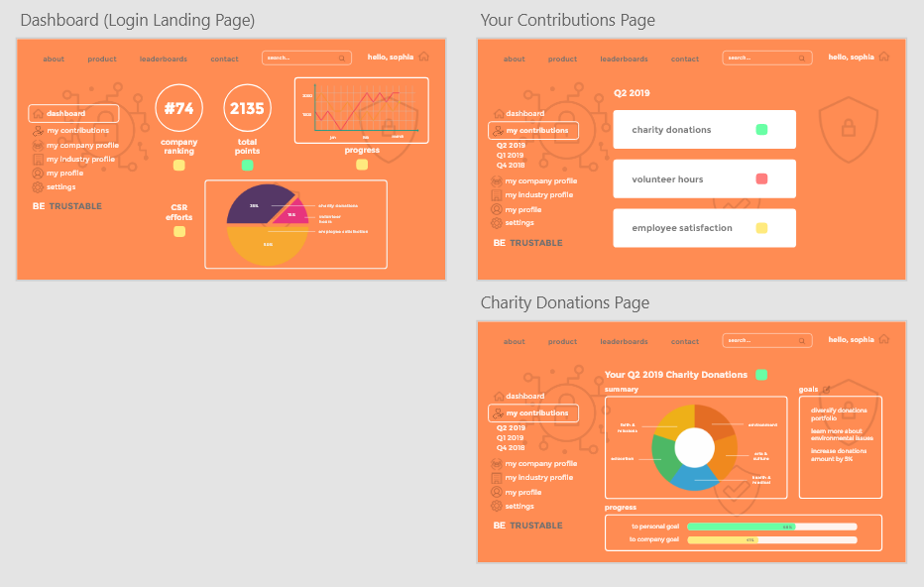
PRODUCT DEMONSTRATION
Interactive product demonstration here.
Notes:
If it’s a company there should be a button for them to contact us and subscribe (so that the company pays us directly - sets up automatic monthly payment - and can be verified with us to be able to have company profile on our webpage, through contracts etc directly with our team). Cause the employee should not have to pay (hence take away the wireframe for payment, tier stuff etc on the webpage login, but add a place on employee/enterprise sign up where it says company name and company email so that we can make sure that the employee is actually part of the company he/she claims to be). but employee through enterprise login/signup should still be able to create a profile on the page to update hours or contributions done to the blockchain (these will be verified through the smart contract).

Slide 9
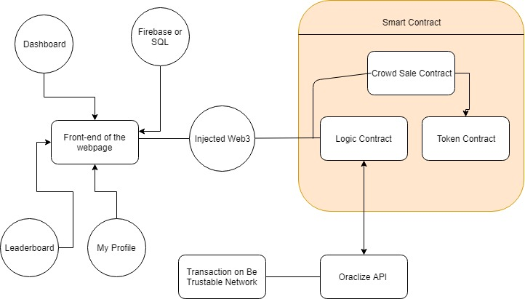
SYSTEM/TECHNICAL ARCHITECTURE
Token Contract, Crowd Sale Contract, and Logic Contract build up to front-end webpage
Front-end webpage displays world leaderboard, personal profile and contributions, and company dashboard

Slide 10
TIMELINE
Q2 2019 | Q3 2019 | Q4 2019 | Q1 2020
Finish product prototype and white paper | Beta testing: offer free subscriptions as incentives to companies around the Bay Area (focus group) | “The Ask”: introduce BETRUSTABLE to wider audience (major corporations in the Bay Area) | Go-to-market plan: offer incentives to initial spawning companies, and add users to the blockchain
Refine features and benchmark against mentor feedback and user validation | Benchmark and revise product according to user feedback from beta testing | Raise funding | Create digital buzz through user testimonials, advertisements, and partnershipsCreate digital buzz through user testimonials, advertisements, and partnerships
Notes:
We want to iterate through and test our product based off of user feedback and are constantly looking to better it. Moving into financials...

Slide 11
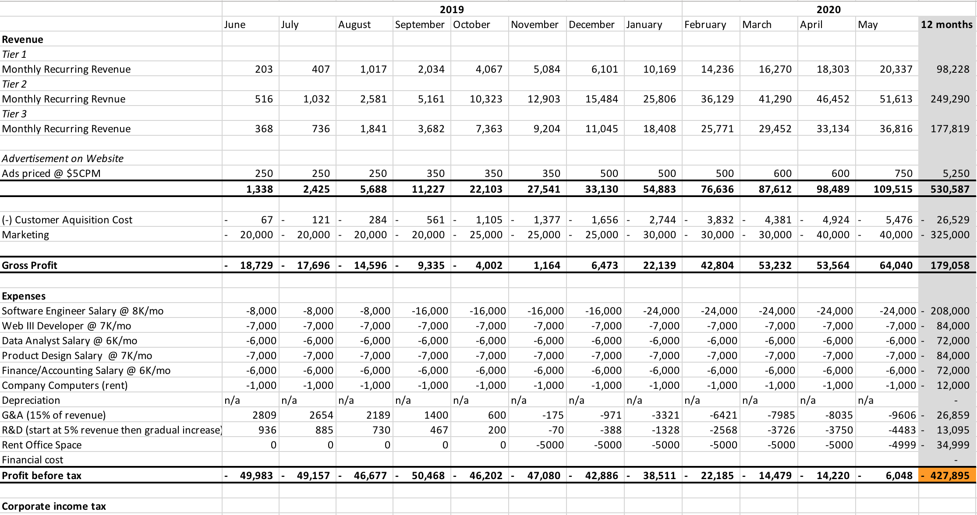
FINANCIAL PROJECTION Y1
Notes:
We want to create a global benchmark CSR score. You have the opportunity to invest now at a steep discount and join us on our journey.
POC bay area Y1, first state (CA) Y2
Monthly break even after 13 months (June 2020)
Accumulative break even after 20 months (January 2021)

Slide 12

Y2 ESTIMATED PROFIT
$4.8 million
THE ASK
$500k
THE GIVE
10% share
Notes:
Within 2 years our annual profit is approaching 5 million USD
at roughly 10x that means an enterprise value of 50 million USD
And that’s only covering one US state.
The price should be 5 million, our ask is only $500K.

Slide 13

THANK YOU

Slide 14
APPENDIX

Slide 15
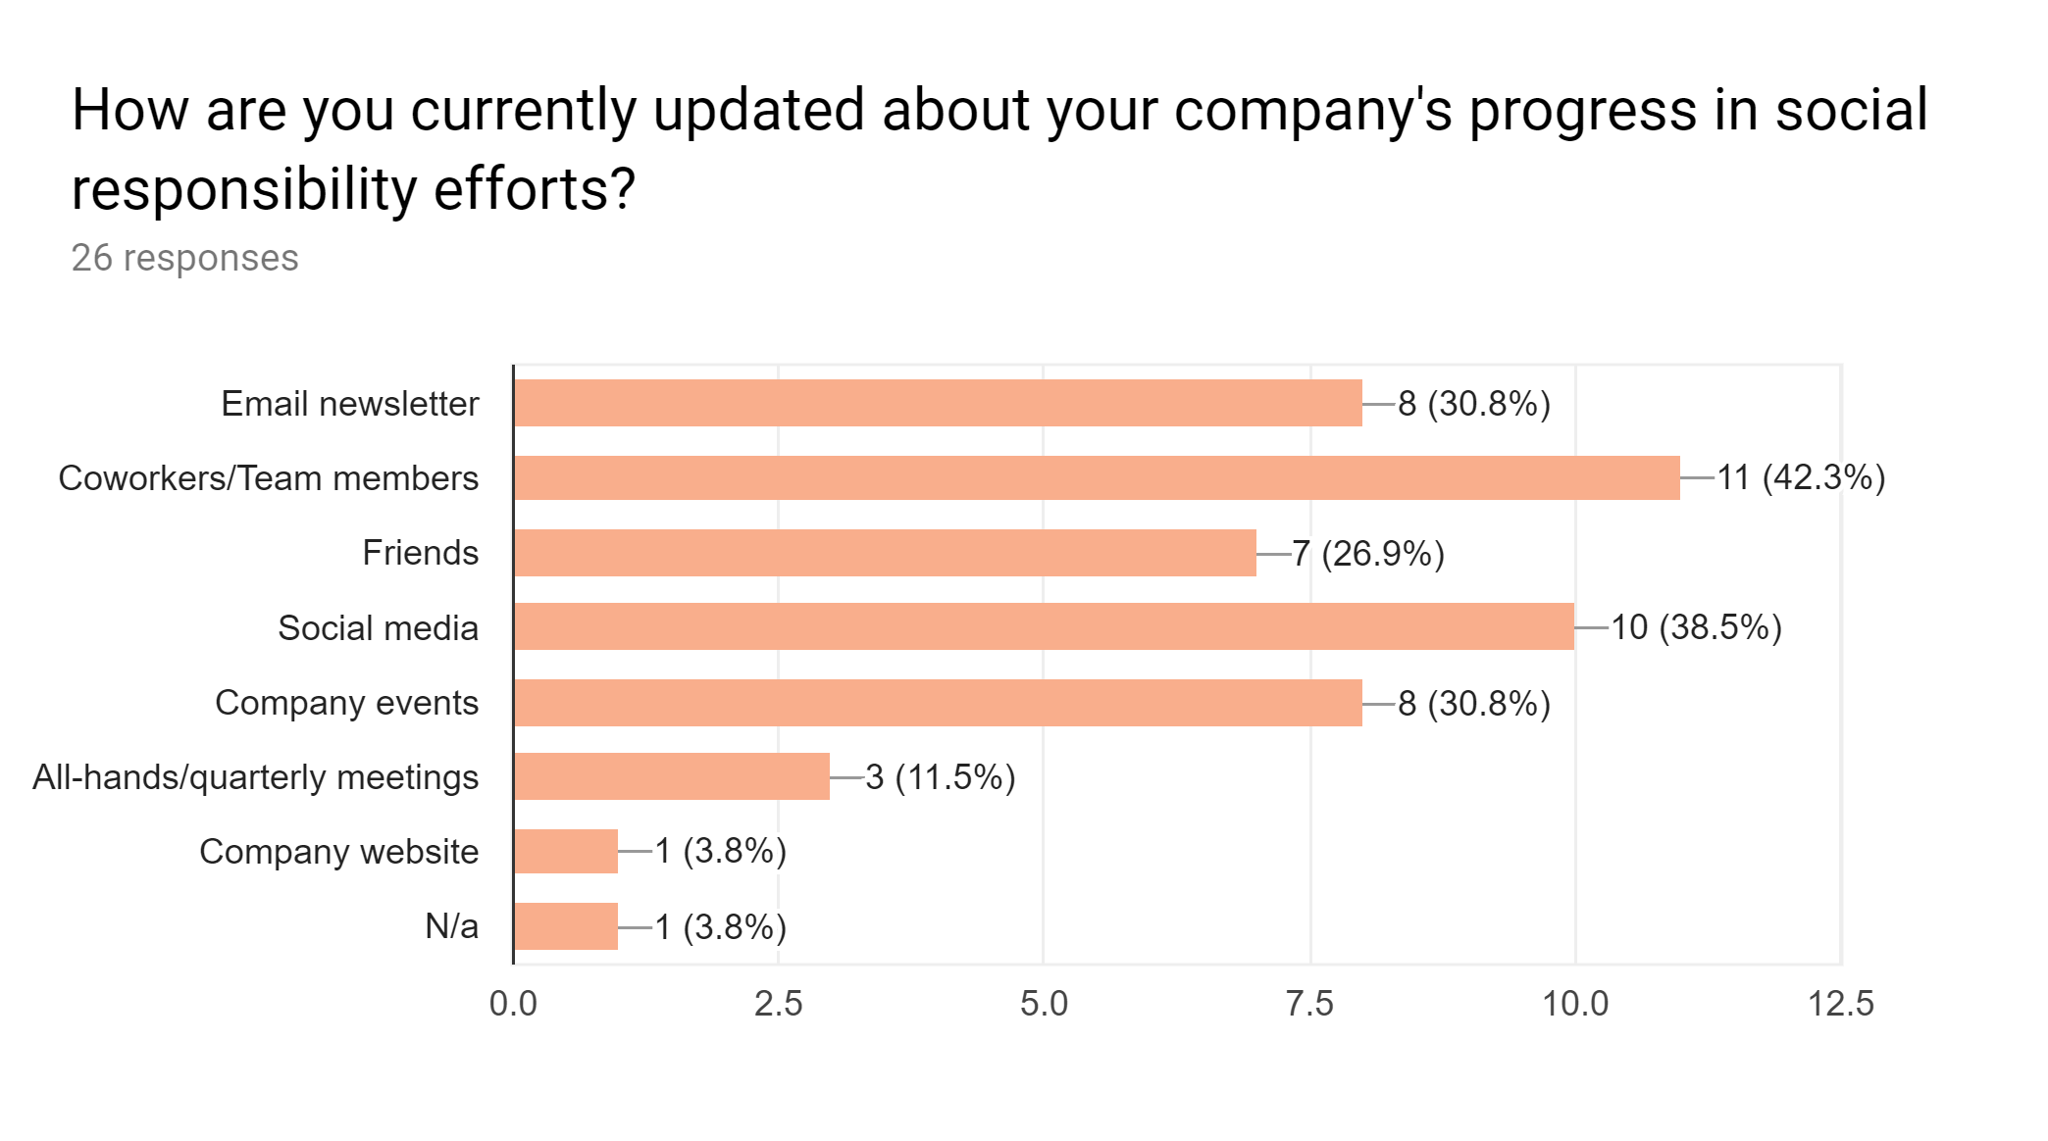
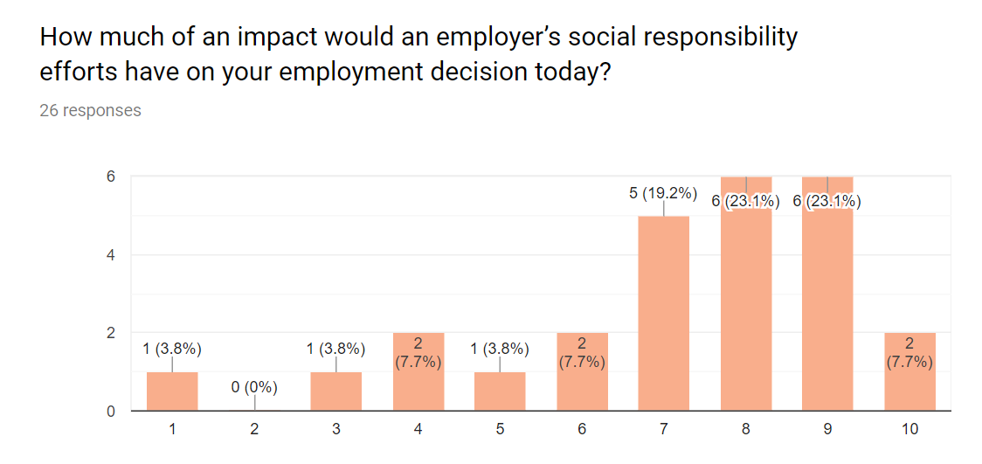
APPENDIX: SURVEY RESULTS

Slide 16
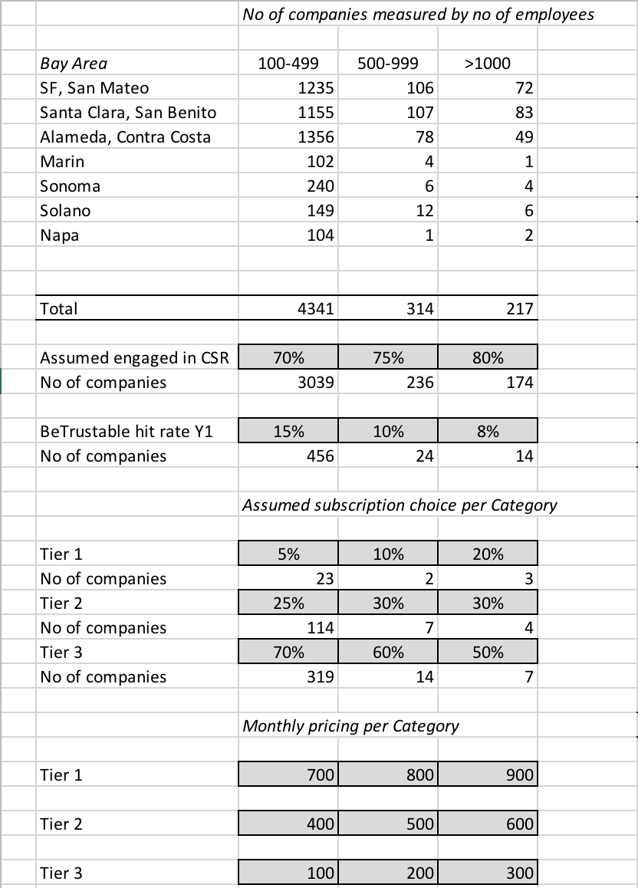
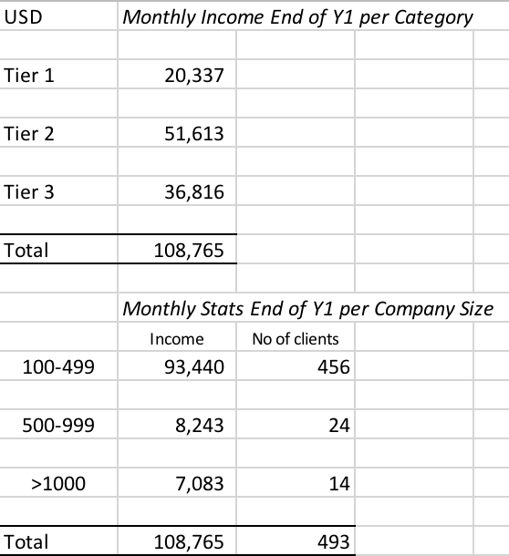
APPENDIX: COMPANY DATA Y1

Slide 17
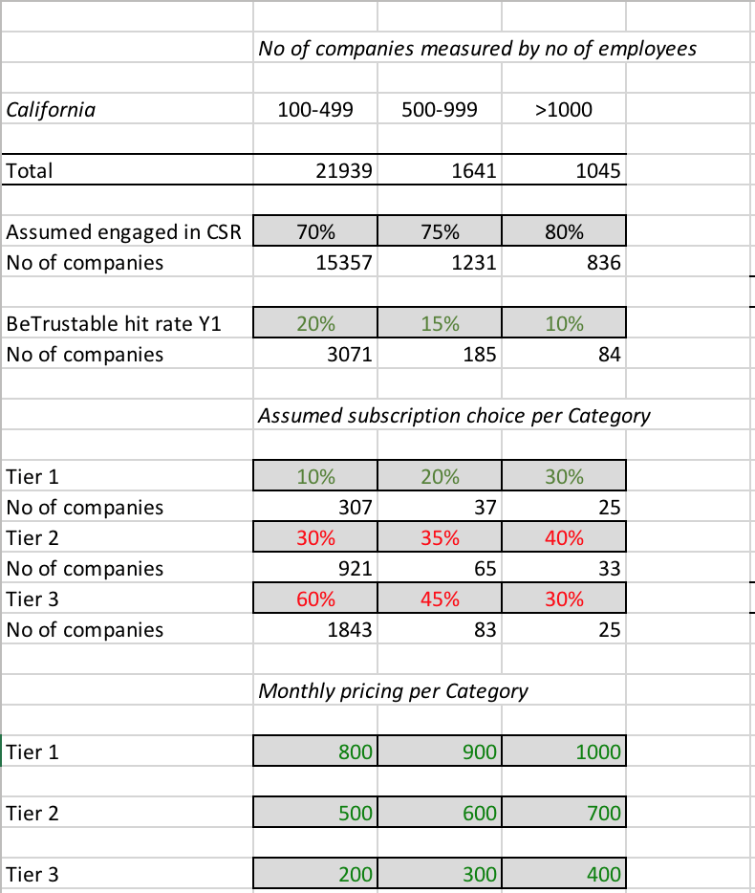
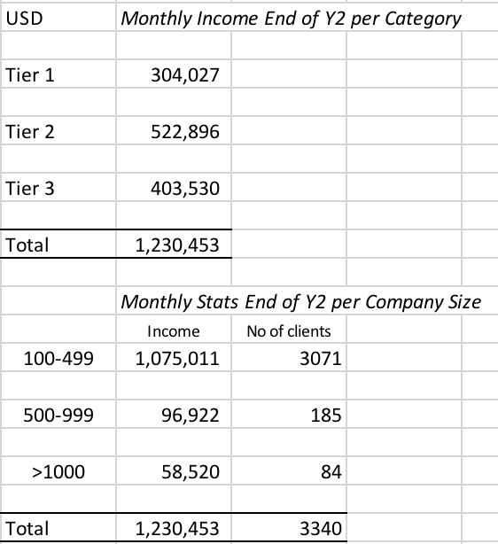
APPENDIX: COMPANY DATA Y2

Slide 18
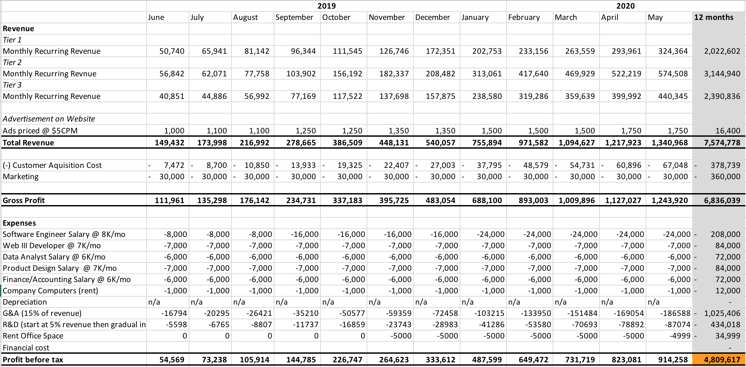
APPENDIX: FINANCIAL PROJECTION Y2

Slide 19
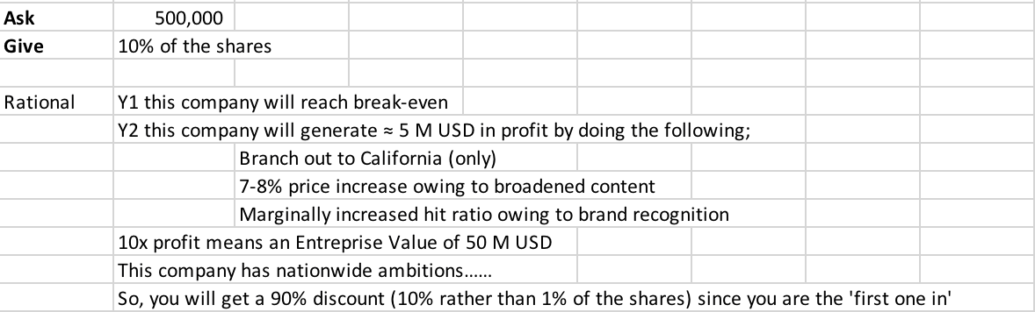
APPENDIX: RATIONALE BEHIND ASK & GIVE

Slide 20
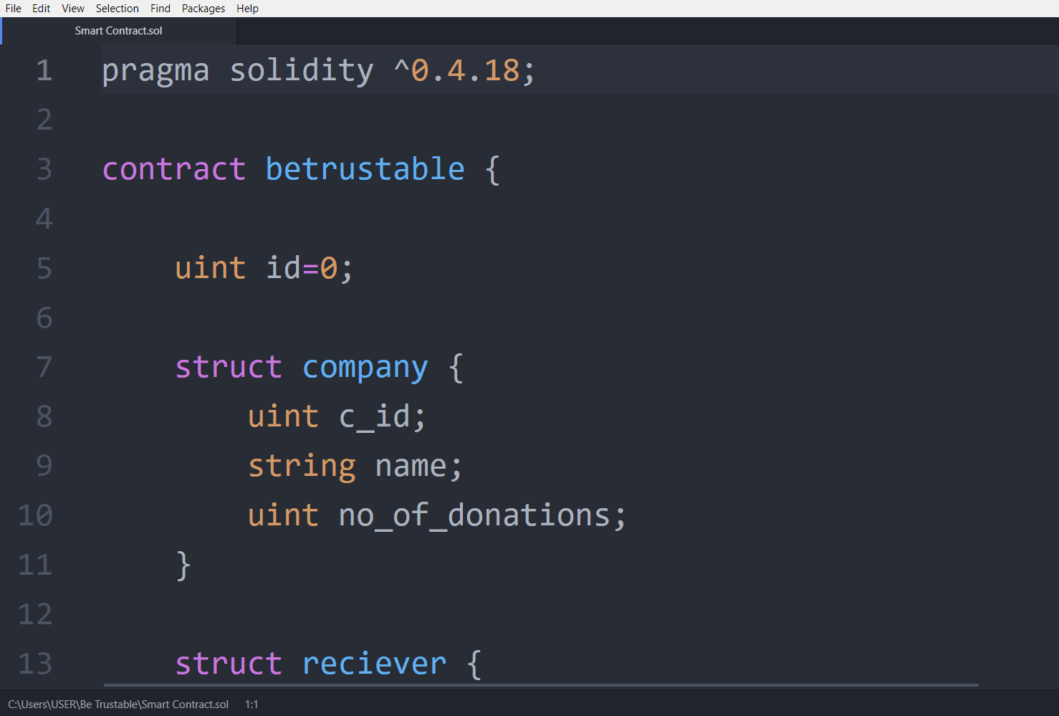
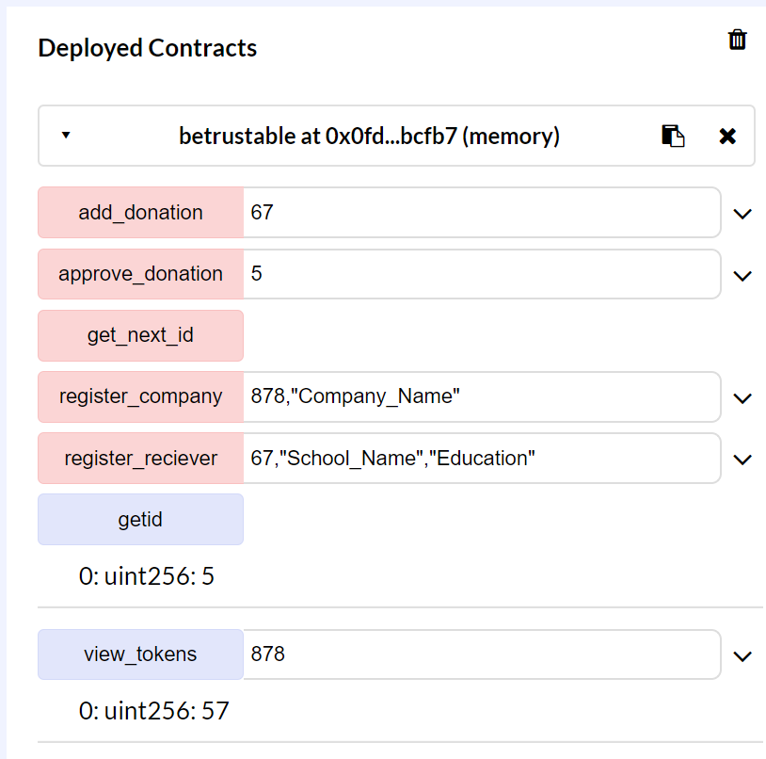
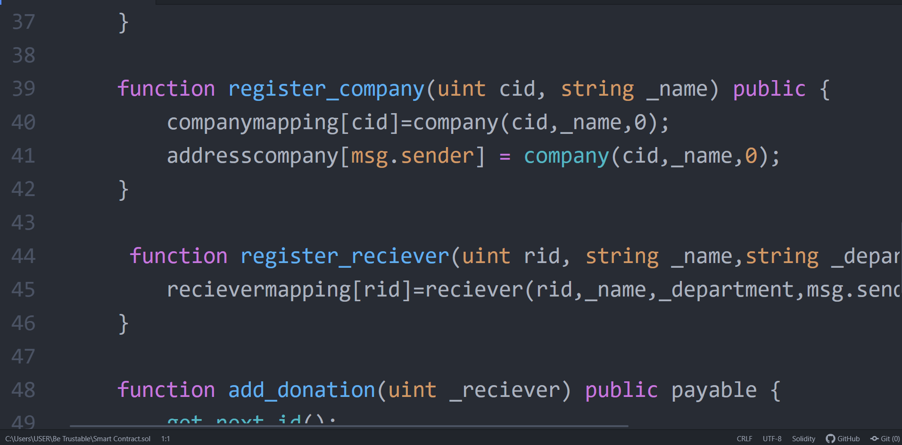
CODE SNIPPET

